Slide 1
Section 2

Slide 2
Glossary of Section 2
Git: A file snapshot system, localised on your computer
GitHub: Where the snapshot can be saved on the internet (for sharing)
Repo: The location of your files on GitHub
Staged: When a file is ready to be included in the next snapshot
Commit: Snapshot of the project included in .git file
Branch: A stream of commits, used to compartmentalise edits
Push: Send the snapshot to GitHub for others to use
Pull: Receive snapshot changes from a branch

Slide 3
Diagrams of Git
Working directory /
Working tree
Staging area
.git directory (Repository)
Working on edits to your files and code, such as in R-Studio
Saved and unsaved files ready to be added to the Staging area.
Files marked to be added to the next snapshot of the project.
Can be only selected files or all files.
Files can be unstaged
The version control.
We can look back and see previous versions of commits.
Where we pull the initial project from

Slide 4
Create/clone a repository "repo"
This is what your repo looks like when its first created. Empty, like creating a new folder on your computer
After you have added a file or if you cloned a repo, you will have files in that repo, represented here by a symbolic "blob". It’s the “main branch", the source of your GitHub project.
Currently all your code and files are saved to this one branch, called "main" by default. We are going to use blobs to explain how a repo works, what GitHub does and how to work with repos and GitHub.

Slide 5
Commit 1.1: Updates
Commit 1
Here we are adding our first commit, meaning:
we have made changes to our branch
told Git to Stage the changes so they are included the next time we commit
and then committed (snapshot taken)
It isn’t good practice to make edits directly to “main" branch though, instead we use other “Branches” to avoid mishaps and mistakes in the "main" branch.

Slide 6
Stage 2.1: Make a branch
Commit 2.1
Commit 2
A branch is a tangent from "main" branch. We use branches write new code, update code, and/or add files to the GitHub repo without the risk of editing/deleting the “main” branch.
For the training lets call the new branch "blue". When creating your own branch try to follow these tips.
Use separators
Start naming with category word
Include authors name
Avoid using only numbers
Avoid long branch names
Be consistent
Commit 1.1
Commit 1

Slide 7
Commit 2
Commit 2.1
Particularly useful if several people are working from the same repo. You can have as many branches working on edits and updates as you want.
Commit 1
Commit 1.1

Slide 8
Commit 2
Commit 2.1
Particularly useful if several people are working from the same repo. You can have as many branches working on edits and updates as you want.
Commit 1
Commit 1.1
Commit 2.1
Commit 2.1

Slide 9
Commit 2.1
Commit 2
Let’s keep it simple with just one branch for the moment.
In this example, you have made a branch (Commit 2) and made some edits (Commit 2.1).
Let's have a closer look at what happens between Commit 2 and Commit 2.1
Commit 1.1
Commit 1

Slide 10
Commit 2
Commit 2.1
When we made Commit 2, it had all the code and files from “main” branch Commit 1.1
We then edit the files, write code, rewrite code, upload files, delete files, etc
When we are happy with our changes we "Stage" the changes, so the next time we commit, anything "Staged" is included. It is possible to make edits on several files, "Stage" some and not others.
If we are editing multiple files, it’s best to have a commit per file edited. We’ll come back to this shortly
When committing, we also have to include a comment detailing what the edits in the snapshot are.
We can also continue to edit, save again, and commit again, Staging and Committing does not prevent further work

Slide 11
Commit 2
Commit 2.1
Push 2.1
The commits haven’t gone anywhere yet, they are still only on your local computer.
Commits wait until a function called “Push” is used.
Commit 1.1
Any/All commits will be “Pushed” up to GitHub.
GitHub will then retain the changes.
Pushing to a branch will replace earlier versions of the branch on GitHub. This is why we use branches, to avoid the “main” branch being overwritten or changed unexpectedly.
Commit 1
Even if something is replaced because Git is a version control system we can always return to an earlier commit

Slide 12
Commit 2
Commit 2.1
Push 2.1
Commit 1.1
After the push Commit 2 has been updated with the edits in Commit 2.1
Commit 1

Slide 13
Commit 2
Commit 1
Commit 1.1
Lets tidy up the graphs and say the edits in Commit 1.1 were accepted into Commit 1 (the same as Commit 2 now has the edits for Commit 2.1)

Slide 14
Commit 1
Commit 2
Commit 1 (“main” branch) has a branch Commit 2 ("blue“ branch)
Commit 2 is an update to Commit 1 (let’s say it adds some extra functionality to Commit 1 code)
At this point, we are happy with Commit 2, and would like our edits to be considered as permanent changes to Commit 1
On GitHub we need to raise a pull request
This alerts someone responsible for Commit 1 “main” branch, that they should review the edits in Commit 2 and consider merging the two branches. This will overwrite “main” branch anywhere there is a change in Commit 2.

Slide 15
PULL REQUEST
Commit 1
Commit 2
There are a few outcomes here, at the basic level, the person responsible for Commit 1 will either accept or reject the changes.
A rule of thumb: the smaller the changes the more likely the request will be a success. If you have change many things, it will take a long time to quality assure and if any part of your change is rejected, the whole change might be reject. Try to keep branch changes small and to the point (where possible)

Slide 16
Commit 1
In this example, the changes from Commit 2 have been accepted into Commit 1. The “blue” branch can be deleted and we are left with the “main” branch like we had at the beginning. If we wanted to make any more changes we could create a new branch and go from there.

Slide 17
GUI steps

Slide 18
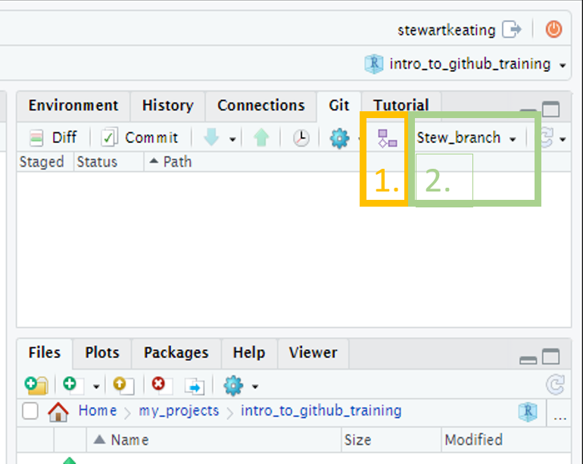
Section 2.1.2 Create a branch
GUI
Create a branch: click the “Git” tab on the right of R-Studio, then the small purple shapes on the right of the screen, add a branch name, and click create.
A pop-up will appear with a message that you have switched to a new branch, and the branch name will update in the Git pane. You can just close the pop-up.
(Note that if the “Sync branch with remote” checkbox is ticked the branch will also be created on the remote GitHub repo, removing the need to do that manually at a later stage.)

Slide 19
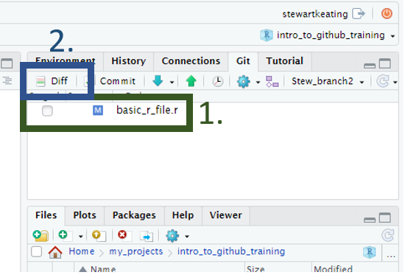
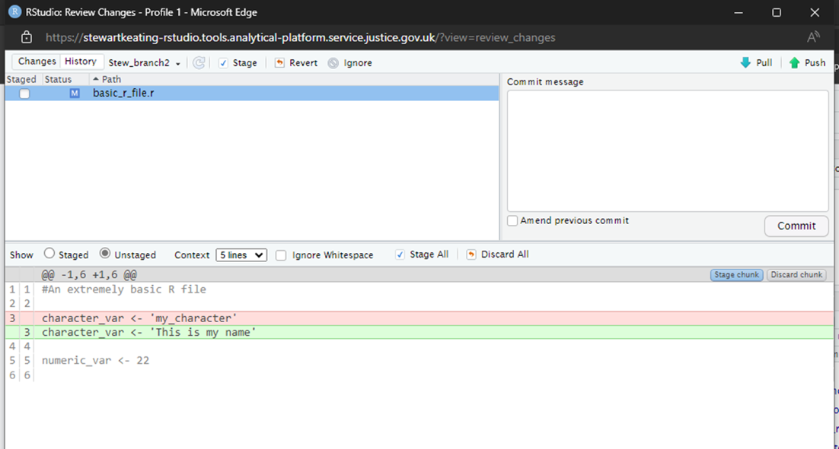
Section 2.2.1 Edit some files, for example write some code to an R script
GUI
If using the GUI, any files that have been edited and saved will appear in the git tab on the right-hand side of the screen. You can view the changes by pressing the Diff button and selecting the file name. Lines highlighted in red have been removed; lines highlighted in green have been added. Lines written in grey have not been changed. The left margin shows the line numbers of the code that has changed.

Slide 20
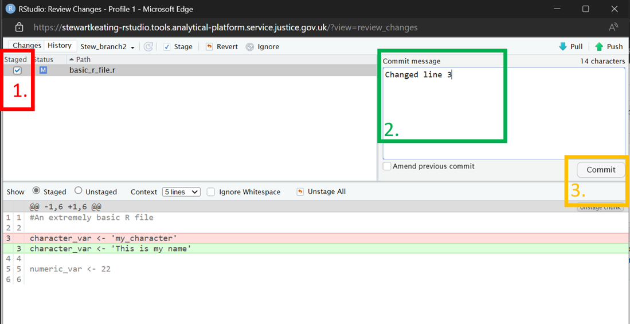
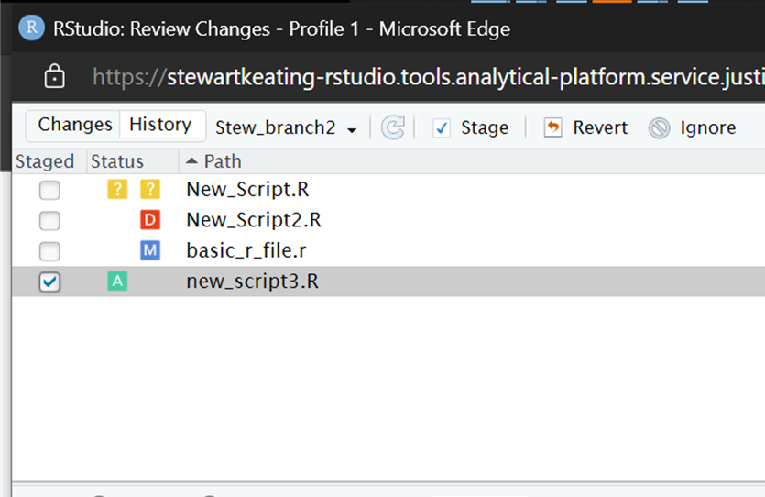
Section 2.2.2 Stage and commit a group of changes
GUI
Click either Diff or Commit to open the Review changes pop-up.
To stage a file, click the check box by the file name. Stage every file whose changes you would like to include in the commit.
Add a commit message in the commit message box.
Click the Commit button.
Changes to files can be seen in the status column.
?
An untracked file – a file that has not yet been staged or committed.
M
A file that has been modified
A
A file that has been added to the staging area.
D
A file that has been deleted.
R
A file that has been renamed.
In this example, the previous line 3 has been replaced by a new line 3.

Slide 21
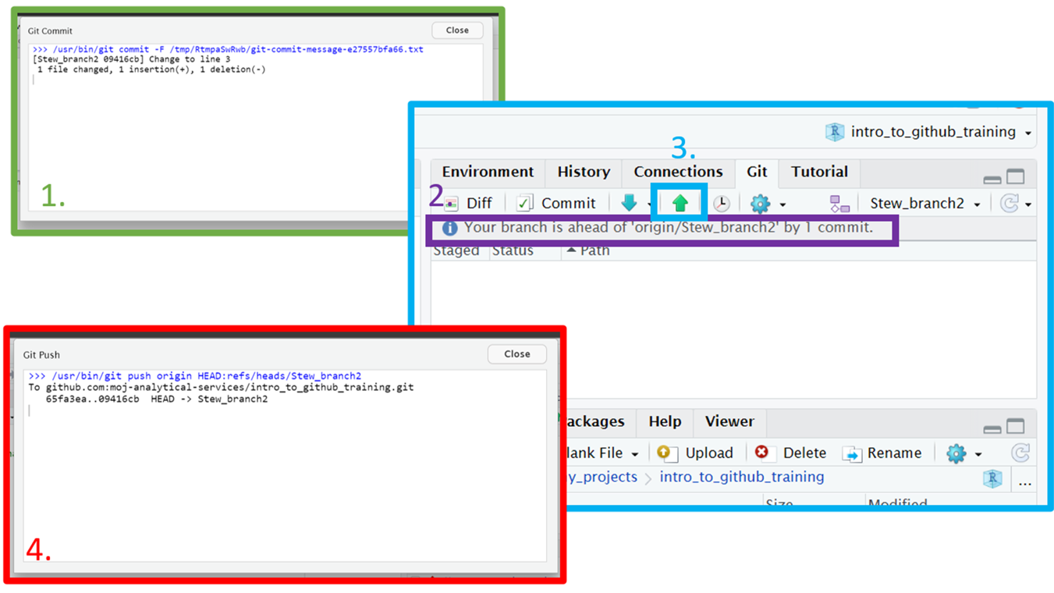
Section 2.3.1 Push changes
GUI
After committing, you will see a pop-up listing any changes, additions, deletions and the commit message.
Back on the main RStudio screen, you can see how commits ahead of the remote GitHub repo you are.
To push your changes to GitHub, click the up arrow.
You will see another pop-up confirming your branch has been updated on GitHub.

Slide 22
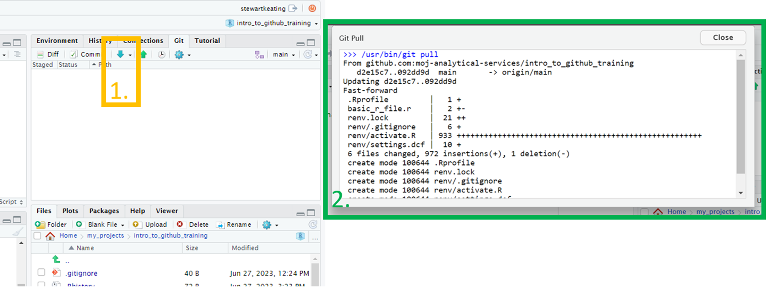
2.4 Pull changes into a local branch
GUI
After the merge has been accepted on GitHub, use the down arrow (next to the push arrow) to pull in the changes on GitHub.
A pop up will appear showing the changes.
In the GUI example screen shots, StewBranch2 was merged with Main branch. The local copy of Main Branch in R-Studio was updated by pulling the changes to Main Branch from GitHub.

Slide 23
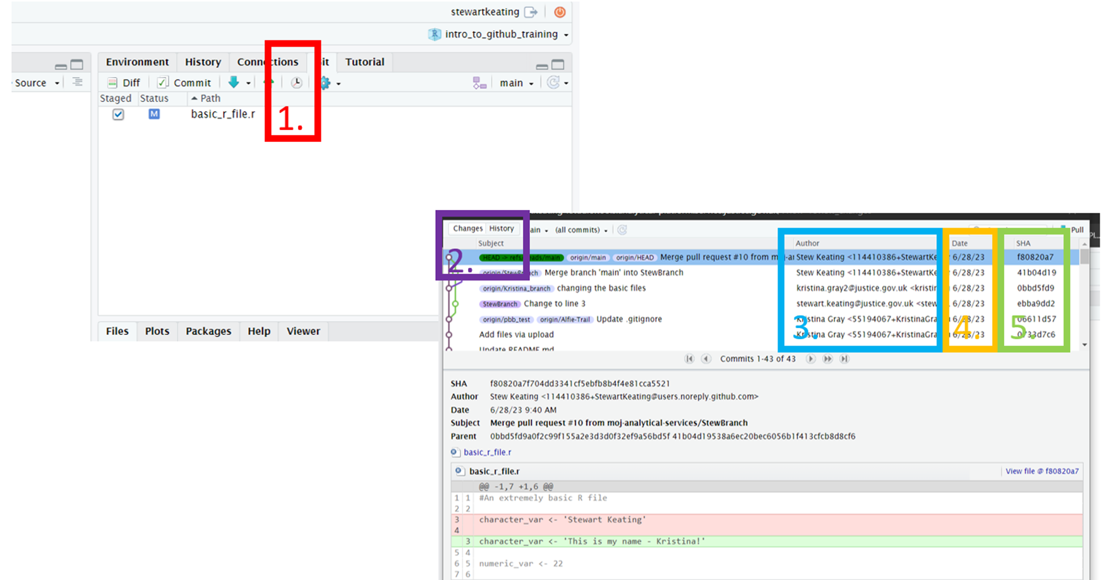
2.5 View the commit history
GUI
In the Rstudio Git pane, click on “History” to see the commit history for the current branch.
We can switch between the DIFF/COMMIT or HISTORY pop ups
3. The author of the commit
4. The date the commit took place
5. The unique ID for the commit

Slide 24
Terminal steps

Slide 25
Section 2.1.2 Create a branch
Terminal
Use the git status command before you create a new branch. git status displays the current state of your files and the staging area: what branch you’re on and which files have been modified or staged since the last commit.
To create a new branch:
git checkout –b my_branch

Slide 26
Section 2.2.1 Edit some files, for example write some code to an R script
Terminal
In the terminal, git status displays the current state of your files and the staging area.
You can also use the git diff command to show changes. Typing the command without any options shows the uncommitted changes since the last commit.

Slide 27
Section 2.2.2 Stage and commit a group of changes
Terminal
Use git add to add files to the staging area.
To stage a single file:
git add my_file.txt
To stage all modified files:
git add .
Use git commit to commit the staged files.
To commit the staged files and open a text editor in which to type the commit message:
git commit
To commit your changes and type an inline commit message (instead of opening the text editor):
git commit -m "My commit message"

Slide 28
Section 2.3.1 Push changes
Terminal
Use git push to push your branch to the remote repo.
To push to a branch that already exists on the remote repo:
git push
If your branch does not yet exist on the remote GitHub repo, the first time you push you will need to create a remote version:
git push –u origin my_branch
The option -u is a shortcut for --set-upstream, which creates a version of the branch on the remote repo.

Slide 29
2.4 Pull changes into a local branch
Terminal
If you are not currently on the main branch, switch to it with:
git checkout main
Use the git pull command to merge commits added to the remote branch into your local branch.

Slide 30
2.5 View the commit history
Terminal
The git log command shows the commit history for the current branch, starting with the most recent. The --oneline option is useful to condense the output. You can limit the number of commits shown with the – option.
For example, to see the most recent five commits on the current branch :
git log --oneline -5

